Slide 1
Survey App
Thomas Christof, Jakob Faschinger, Michael Hansal
IPC (Institute for Pervasive Computing, JKU Linz)
Embedded and Pervasive Systems SS2016
JKU Linz, June 21, 2016

Slide 2
Survey App :: PROJECT IDEA
Problem statement
- Immediate feedback essential
- Not all students are willing to return feedback
Solution
- Create surveys on demand with predefined answers
- Student are able to return feedback
- Immediately see any given feedback
IPC

Slide 3

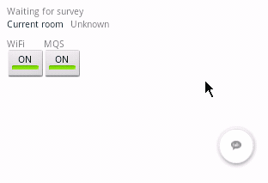
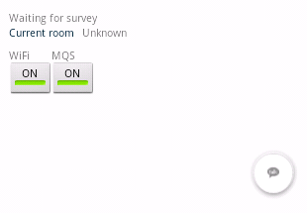
Survey App :: VIDEO OR LIVE DEMO
Create a survey Answer a survey
IPC

Slide 4

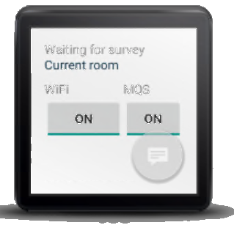
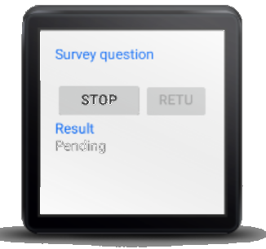
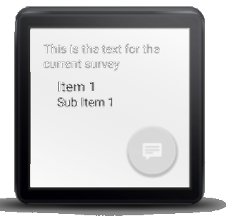
Survey App :: DETAILS
4 Activities
- Listen for a survey
- Answer a survey
- Create a survey
- Survey result
Libraries
- com.android.support:appcompat-v7:23
- com.android.support:gridlayout-v7:23
- com.android.support:design:23.3.0
2 Services
- WiFi Locator (RSSI Fingerprinting)
- Communication (MQS)
IPC

